Slide 1
Part C:
Solutions
By: Sheena B., Melissa H., Julia K., Marina M., Drew S.

Slide 2
Land Acknowledgment
Thompson Rivers University campuses are on the traditional lands of the Tk'emlúps te Secwépemc (Kamloops campus) and the T’exelc (Williams Lake campus) within Secwépemc'ulucw, the traditional and unceded territory of the Secwépemc. The region TRU serves also extends into the territories of the St’át’imc, Nlaka’pamux, Tŝilhqot'in, Nuxalk, and Dakelh.

Slide 3
Overview of Situation
Gerdy is a young single mother to a 2-year-old child. She was relatively new to Kamloops with no real support system when she became pregnant just before the COVID-19 pandemic. She experienced the regular baby blues after the birth of her child, but was unable to access services in her area as they were closed to in-person visits. Gerdy didn't have the at-home resources to attend any virtual postpartum support, therefore as time passed, her mental health deteriorated, and she developed Postpartum Depression (PPD). Unable to access resources during her time of need, being a single parent with limited resources, and having no family or friend support to guide her through her postpartum period, Gerdy presented frequently to the emergency department seeking mental health support.

Slide 4
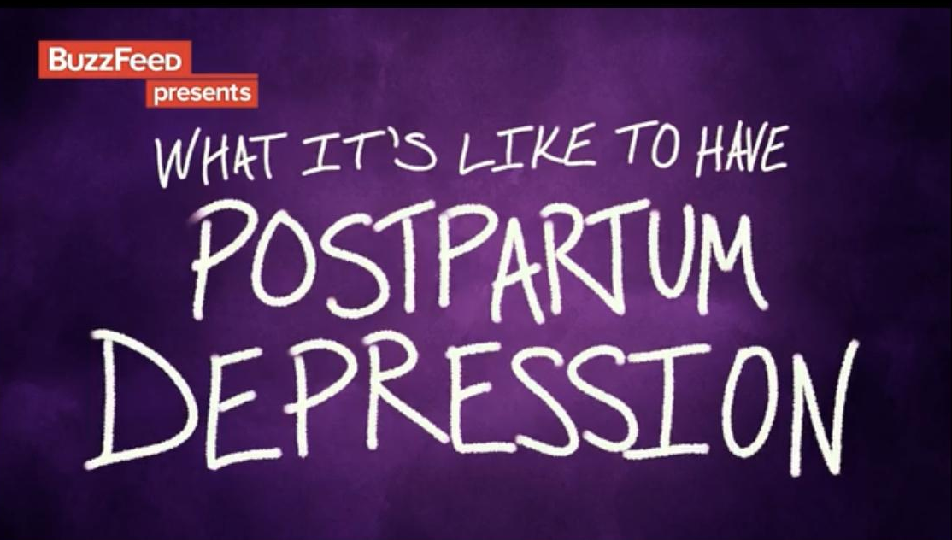
Video: Moms Talk About Their Postpartum Depression
(BuzzFeedVideo, 2016, April 3).

Slide 5
Solution #1
Postpartum Care Centres
Studies took place in Korea. Postpartum care centres known as Sanhujoriwons.
Overview:
In South Korea, commercial care facilities, or Sanhujoriwons, have become significant establishments which support the physical recovery after childbirth, for mothers. After giving birth in the hospital, the mother will then be admitted to a centre, where the average duration of stay at one of the centers is around 2 weeks. It is novel to Kamloops and it has not been implemented in the local context.
(Song et al., 2023).

Slide 6
Solution #1
Postpartum Care Centres
Benefits (strengths) of this centre:
Mothers who stay here prioritise their postpartum recovery.
Found to improve maternal role confidence in first-time mothers.
Experience fewer health-related problems within themselves & their babies (Song et al., 2023).
Rationale for Selecting:
Studies have shown that women satisfied with their postpartum care receive greater parenting efficacy, breastfeed earlier and more effectively, and experience lower health-related problems for themselves and their babies. These reasons made us choose this center as one of our solutions. No in-patient centre exist like this in Kamloops (Song et al., 2023).

Slide 7
Postpartum Care Centres
Challenges:
Babies that are taken from mothers during sanhujori (Korean postpartum care) can inhibit bonding, which include breastfeeding and newborn care mother-infant attachment. To address this problem, postpartum care services should aim to enhance the addition of maternal roles while also promoting postpartum recovery.
High income families were more likely to say that they were satisfied with their care.
A lack of postpartum care services at this centre could affect the mother’s health recovery, attachment formation, and acquiring a maternal role.
Lack of adequate education related to childcare. Centre needs to implement better education, such as breastfeeding experts (ie. Lactation consultant).
Expensive: $2-5,000 dollars in Canadian which is $1,300 in Korean won.
(Song et al., 2023).

Slide 8

Solution #2
Is E-Health the answer?
The study took place in the UK. Psychosocial intervention applications (apps).
Overview:
Psychosocial apps that are used to prevent postpartum depression. Apps can be accessed anywhere in the world if you have a device, moms could be accessing it in Kamloops. It is novel to Kamloops and it has been implemented in the local context (Miura et al., 2023).
Notes:
A study found described psychosocial apps (the study utilized 16 different apps in the study) that are used to prevent post partum depression. They have been proven to be effective and not only include programs to directly prevent PPD but other psychosocial factors that contribute to PPD and affect mental health. As it is described that a history of mood disorder and anxiety is a risk factor for postpartum depression.
Miura, Y., Ogawa, Y., Shibata, A., Kamijo, K., Joko, K., & Aoki, T. (2023). App-based interventions for the prevention of postpartum depression: A systematic review and meta-analysis. BMC Pregnancy and Childbirth, 23(1). https://doi.org/10.1186/s12884-023-05749-5
Call 1-833-TLC-MAMA (1-833-852-6262)—The National Maternal Mental Health Hotline
24 hours a day, 7 days a week in English, Spanish, and more than 60 other languages
Offer support & information related to before, during, and after pregnancy
24 hour hotline, specifically for postpartum mothers
Call BC Women's Hospital at 1-888-300-3088 ext. 2025 (toll-free in BC) or call 604-875-2025 (in Greater Vancouver) to find out how to see a specialist in postpartum depression or anxiety
https://www.nichd.nih.gov/ncmhep/initiatives/moms-mental-health-matters/find-help

Slide 9
Is E-Health the Answer?
Strengths:
Psychosocial apps have been proven to be effective .
Targeted to prevent PPD, improved EPDS score.
App has been implemented before.
Supports individuals that may be faced with lack of access to resources=mothers can use their smartphones rather than face-to-face
(Miura et al., 2023).
Rationale for Selecting:
As technology is at the forefront of today’s world, we thought incorporating an app to help mothers facing PPD could be incredibly beneficial (Miura et al., 2023).
Challenges:
Fear of E-health interventions being less effective than in-person.
Complicates deciphering most effective app to be used for individual mother.
Individuals may not have access to technology or devices
(Miura et al., 2023)
Notes:
The present value of total lifetime costs of perinatal depression was £75,728 per woman in the UK [10]. This means that the prevention of postpartum depression is essential
A study we found presented the results of current apps beig utilized and it was found that they actually improved the EPDS score; furthermore, they may prevent postpartum depression.
The authors talked about the idea that the COVID-19 pandemic has forced us to limit face-to-face interventions for postpartum depression despite their increasing demand. This is a barrier for interventions to prevent postpartum depression, but app-based interventions that include an automated component can be a method that can overcome this barrier.
Utilizing an app as a solution helps to support individuals that may be faced with lack of access to resources= Pregnant and postpartum women can use their smartphones or tablets to voluntarily engage in postpartum depression prevention, rather than face-to-face.
Challenges of this solution includes, fear of E health interventions being less effective than in-person. Other limitations include the basis of all of the apps analyzed some were based on CBT therapy others on mindfulness, and also included psychoeducation. Which complicates deciphering the most effective app to be used for each individual mother.
Miura, Y., Ogawa, Y., Shibata, A., Kamijo, K., Joko, K., & Aoki, T. (2023). App-based interventions for the prevention of postpartum depression: A systematic review and meta-analysis. BMC Pregnancy and Childbirth, 23(1). https://doi.org/10.1186/s12884-023-05749-5

Slide 10
Priority Solution:
Solution #3:
Centering Pregnancy

Slide 11
Solution #3
Centering Pregnancy
Based in Boston, MA
Prenatal Support Groups Sessions
Postpartum Reunion
Notes:
Boston MA. prenatal support and a postpartum reunion.
Better Health Outcomes - expanded to healthier babies and eliminating racial disparities
Self Care - active engagement in the healthcare process
Self Confidence - better prepared for L&D and newborn care, with fewer ER visits
More time with HCP - 10x more time than average
Support & Friendship - Friendship and resources during exciting but challenging times of parenthood
Learning and Fun - Active engagement with facilitators and peers leads to greater understanding and change in behaviour

Slide 12
What does it involve?
Group Sessions
Step 1
8-10 women in the same trimester
Total of 10 sessions each 90-120 minutes long
Assessment
Step 2
Moms are encouraged to monitor their own care throughout the process
Education
Step 3
Using adult learning styles
Discussions and interactive activities used to address timely health topics
Support
Step 4
Nutrition, pregnancy discomforts, stress management, L&D, breastfeeding, etc
Notes:
Group care focused on 10 prenatal visits, each visit being 90 minutes to 2 hours long - giving women more time with HCP and engagement with fellow group members.

Slide 13
Why would this work to solve our problem?
Study Outcomes:
Women linked to these groups were often younger and single compared to their standard cohort, as well as nulliparous.
Improvement in quality of life.
Improvements in perceived social support.
Improvements in breastfeeding rates.
Concurrent decreases in screens of postpartum depression.
Higher reduction in symptoms of psychological distress.
Lower pregnancy-associated distress and higher maternal functioning scores.
(Liu et al., 2021).
Notes:
RE breastfeeding, the study discussed how the group can provide layers of resiliency to self esteem and self-efficacy, as well as better way to disseminate BFing education.

Slide 14
Solution #3:
Centering Pregnancy
We believe that solution three is the most relevant, is highly feasible, and has a high chance of success, if implemented in the local context.
Rationale:
Increased social support removes a barrier that impacts young single mothers
who have reduced access to normal avenues of support (ie. family and
spouses/partners)(Alsabi et al., 2022; Sangsawang & Sangsawang, 2023).
Group education settings can improve maternal self-efficacy scores which can
improve the mother’s ability to care for their child and reduce depressive
symptoms (Sangsawang & Sangsawang, 2023).
Increased time with HCP can lead to more opportunity to listen to patients who may
not be able to freely share their experiences deviating from social expectations (Chrzan-Dętkoś, Walczak-Kozłowska, & Lipowska, 2021).
Multiple layers of care from a variety of actors can prevent isolation, positively impact psychological burden, and create a safe and secure environment during and after a pandemic (Furudate, Takahashi, & Kinjo, 2023).

Slide 15
Challenges of Implementing this Solution within Kamloops:
In our research, authors describe challenges surrounding space, location, scheduling, and recruiting
Lack of staff available in Kamloops
Lack of participants due to group setting
It is a large paradigm shift from traditional individual prenatal care
Lacks continuity into the postpartum period
Potential lack of financial support
Potential lack of motivation of participants
Notes:
https://www.ncbi.nlm.nih.gov/pmc/articles/PMC4772136/

Slide 16

Which solution resonated with you,
and why?
Join at
slido.com
#1648 038

Slide 17
Thank you!
Any Questions?

