Slide 1
Bias in Healthcare
Indigenous Peoples
Gabby, Matthew, Thomas, and Ton

Slide 2
Land Acknowledgement
Thompson Rivers University campuses are on the traditional lands of the Tk’emlúps te Secwépemc (Kamloops campus) and the T’exelc (Williams Lake campus) within Secwépemc’ulucw, the traditional and unceded territory of the Secwépemc. Our region also extends into the territories of the St’át’imc, Nlaka’pamux, Nuxalk, Tŝilhqot’in, Dakelh, and Syilx peoples.

Slide 3
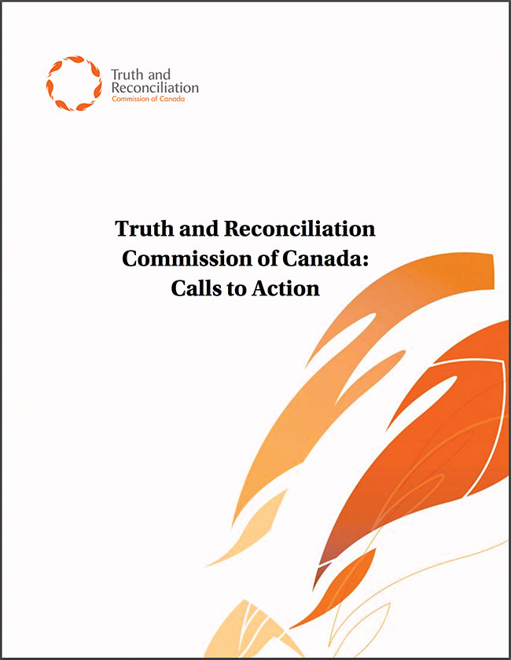
22. We call upon those who can effect change within the Canadian health-care system to recognize the value of Aboriginal healing practices and use them in the treatment of Aboriginal patients in collaboration with Aboriginal healers and Elders where requested by Aboriginal patients.
23. We call upon all levels of government to:
i. Increase the number of Aboriginal professionals working in the health-care field.
ii. Ensure the retention of Aboriginal health-care providers in Aboriginal communities.
iii. Provide cultural competency training for all healthcare professionals.
(Truth and Reconciliation Commission of Canada, 2015)

Slide 4
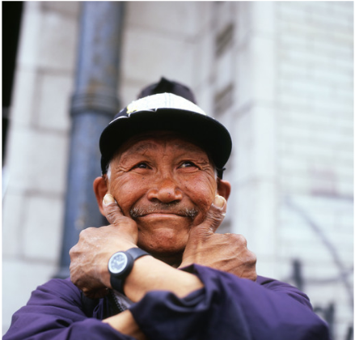
Our Scenario…
“John”, an Indigenous man in his 60s on a medical unit had attempted suicide by shooting himself under the chin with a shotgun. The patient had incurred brain damage and had severe nerve pain. Moreover, as the patient had been regularly maxing out their pain medication dosing, the nurses have been unable to give him more. The patient had requested the use of herbal analgesia but had been denied it as it is not approved by the hospital, he believes the staff are denying him pain medications. He also confided that he cannot wait to leave the hospital as he feels like a burden to the healthcare system.

Slide 5
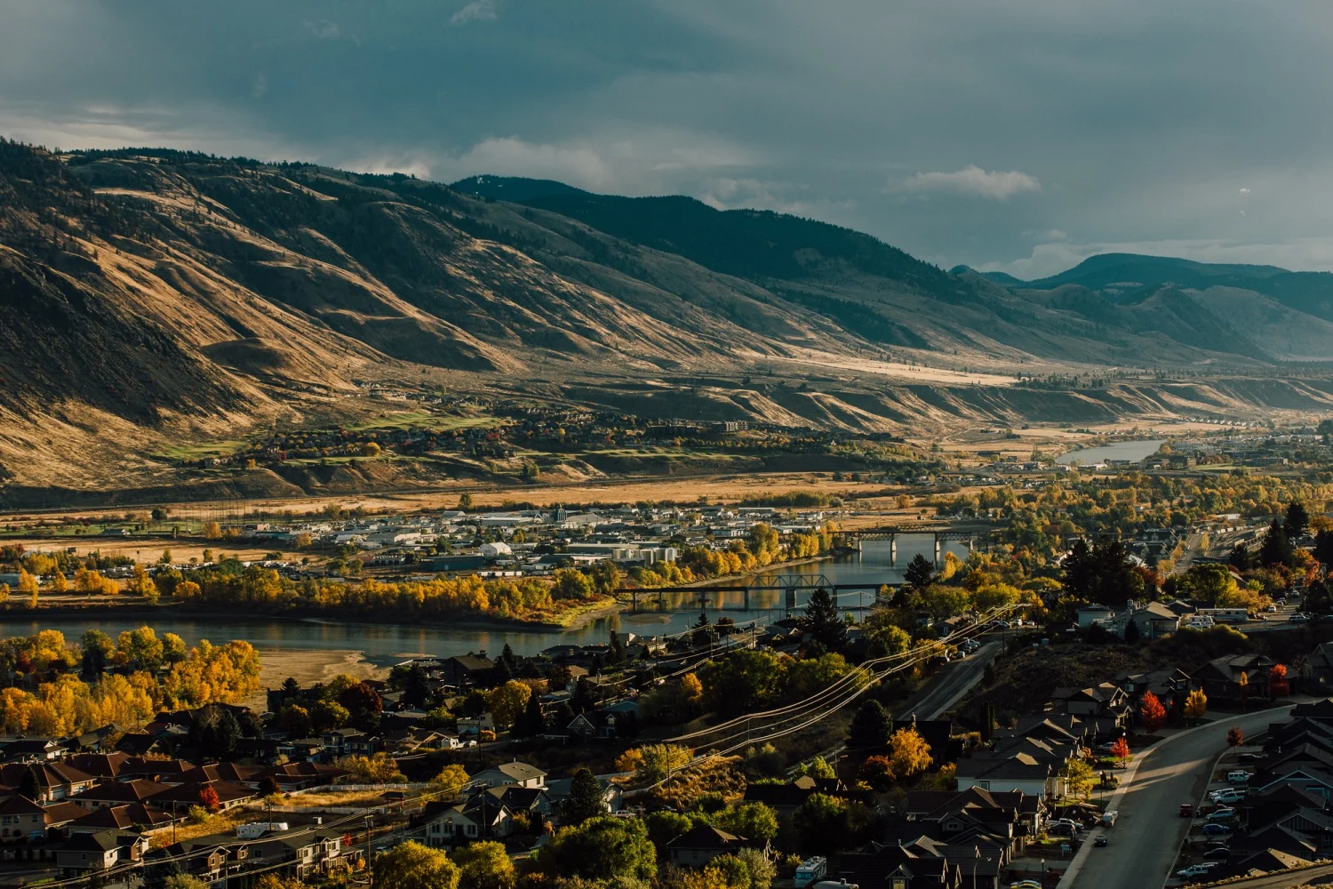
Environmental Scan

Slide 6
Environmental Scan - Downstream Approach
Aboriginal Patient Navigators
Aboriginal Partnerships
Liaison and referral services for Indigenous patients in RIH. Provides education to HC team. (Interior Health, n.d.)
Joint committees that focus on advocating for Indigenous Health and Wellness (Interior Health, n.d.)
First Nations Health Authority
Patient Care Quality Office
Community based services focusing on health promotion and disease prevention (FNHA, 2023)
Provide feedback on care experience while at RIH. Provides Indigenous specific assistance. (Interior Health, n.d.)

Slide 7
Environmental Scan - Upstream Approach
TRU Revised Curriculum
San’yas Training
Need to include Indigenous methodology such as Two-eyed seeing in teaching (Kurtz, 2017)
Online Indigenous cultural safety training program (Turpel-Lafond, 2020)
Interior Health iLearns
APN Education
Basic online training on Indigenous health (Interior Health, n.d.)
Provides on unit education to HC staff. Hosts hospital-wide seminars (Interior Health, n.d.)

Slide 8
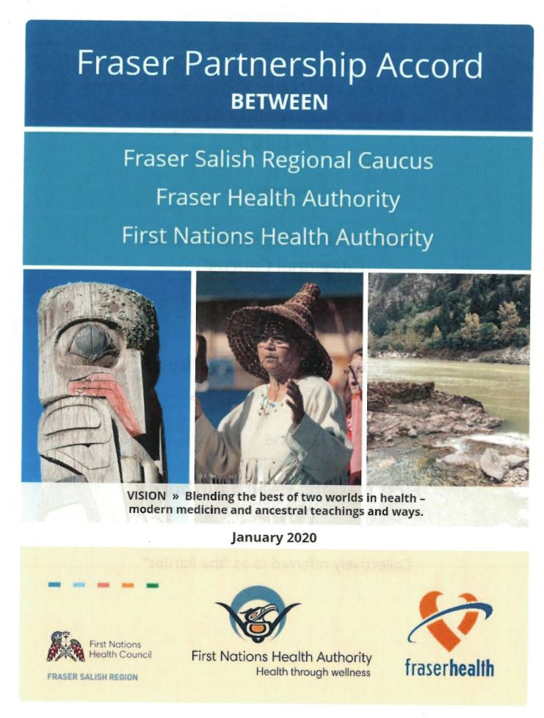
Fraser Partnership Accord
Participating Parties:
Fraser Salish Regional Caucus
Fraser Health Authority
First Nations Health Authority
Signed in 2020 and was the first of its kind in British Columbia
Purpose:
“Everyone working together”
Improve health outcomes for First Nations People residing in the Fraser Salish Region
(Fraser Partnership Accord, 2020)

Slide 9
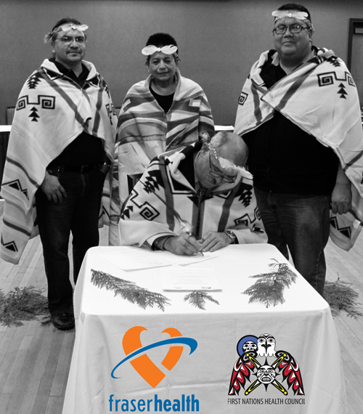
Solution 1: Inter-Agency Collaboration
Strengths
Invites Indigenous perspectives into the decision making processes and resource allocation
First Nations Health Authority notified when an Indigenous person is admitted into the hospital
Helps Indigenous patients to transition into the western health care system
Exposes nurses to more Indigenous health practices
Forces nurses to face their own biases when First Nations Health calls to check on the Indigenous patients
Challenges
More of a downstream approach
Puts more responsibility on First Nations Health rather than Interior Health
Possibility of nurses abusing this partnership and passing everything off to First Nations Health (already happening with the APNs)
(Fraser Partnership Accord, 2020)
Not a priority solution because it doesn’t directly address the bias of nurses and other healthcare professionals

Slide 10
Solution 2 - Australian Men’s Yarning Circles (Cavanagh et al., 2022)
Various men's groups in Australia in which Indigenous men are given supportive environments where they can be a part of a community.
Purpose: of these groups is to empower these individuals by providing activities to strengthen interpersonal skills, voice their own opinions.
Pros:
Targets the social determinants that indigenous individuals experience,
Supports these individuals in their community and capacity building,
Helps educate men on their illness,
Provides a safe environment where indigenous
Cons:
Doesn’t directly address the bias that indigenous individuals face specifically in healthcare,
more of a preventative measure rather than addressing the current bias that this population faces in healthcare
Not Priority!!

Slide 11
Solution 3: Education for Healthcare Workers
San’yas anti-racism indigenous cultural safety training program
San’yas is an online cultural safety training program developed in 2009 and delivered by the Provincial Health Service Authority’s (PHSA) indigenous health program
Pros:
Strengthen their knowledge, awareness, and skills for working with and providing service to Indigenous people and communities
Encourages learners in correcting, rebuilding and transforming systems to uproot Indigenous-specific racism
Cons:
Only 15% of healthcare workers from 2009 to 2020 reported taking the San’yas training program
Many other health authorities failing to create region specific training
Lack of funding leading to poor access
Not universally offered or funded consistently across the B.C. health care system
Is not currently governed or designed with the involvement of first nations or metis peoples
(Turpel-Lafond, 2020)

Slide 12
Our Priority Solution:
Mandatory Education for Healthcare Workers
We aim to propose a cultural safety training program that addresses the shortcomings of others
Recommendations from: Cullen et al., Maclean et al., Webb et al., In Plain Sight Report and Lisa the APN
Trauma informed care training including education on the history of indigenous people in Canada.
Involvement of indigenous people in the creation and dissemination of the program
Mandated and compensated for all interior health healthcare employees
Use of in person lectures, seminars, and simulations
(Cullen et al., 2022; Maclean et al., 2023; Tarpel-Lafond, 2020)

Slide 13
Solutions
01
02
03
Inter-Agency Collaboration
Community Support Groups
Mandatory
Education
Fraser Partnership Accord
Australia’s Indigenous Men Support Group
San’yas Indigenous cultural safety training

Slide 14
Thank you for listening!!

Slide 15
References
Cavanagh, J., Pariona-Cabrera, P., & Bartram, T. (2022). Culturally Appropriate Health Solutions: Aboriginal men ‘thriving’ through activities in men’s sheds/groups. Health Promotion International, 37(3). https://doi.org/10.1093/heapro/daac066
Cullen, P., Mackean, T., Walker, N., Coombes, J., Bennett-Brook, K., Clapham, K., Ivers, R., Hackett, M., Worner, F., & Longbottom, M. (2022). Integrating Trauma and Violence Informed Care in Primary Health Care Settings for First Nations Women Experiencing Violence: A Systematic Review. Trauma, Violence, & Abuse, 23(4), 1204-1219. https://doi.org/10.1177/1524838020985571
First Nations Health Authority [FNHA] (2023). What We Do. First Nations Health Authority. https://www.fnha.ca/what-we-do
Fraser Partnership Accord (2020, January). First Nations Health Council, First Nations Health Authority, & Fraser Health Authority. https://www.fnha.ca/Documents/Fraser_Partnership_Accord_2020.pdf
Interior Health. (n.d.). Aboriginal Patient Navigators [Brochure]. https://www.interiorhealth.ca/sites/default/files/2021-11/APN%20Brochure.pdf
Interior Health. (n.d.). Aboriginal Patient Navigator Service. Interior Health. https://www.interiorhealth.ca/services/aboriginal-patient-navigator-service
Interior Health. (n.d.). Aboriginal Patnerships. Interior Health. https://www.interiorhealth.ca/about-ih/aboriginal-partnerships
Interior Health. (n.d.). Patient Care Quality Office. Interior Health. https://www.interiorhealth.ca/information-for/patients-and-visitors/patient-care-quality-office
Kurtz, D. L., Mahara, S., Cash, P., Nyberg, J., & Patrick Moller, E. (2017). Indigenous methodology in understanding indigenous nurse graduate transition to practice. International Indigenous Policy Journal, 8(4). https://doi.org/10.18584/iipj.2017.8.4.9
MacLean, T. L., Qiang, J. R., Henderson, L., Bowra, A., Howard, L., Pringle, V., Butsang, T., et al. (2023). Indigenous Cultural Safety Training for Applied Health, Social Work, and Education Professionals: A PRISMA Scoping Review. International Journal of Environmental Research and Public Health, 20(6), 5217. MDPI AG. Retrieved from http://dx.doi.org/10.3390/ijerph20065217
Provincial Health Services Authority [PHSA] (2023). San'yas ant-racism indigenous cultural safety training program. San'yas. Retrieved November 11, 2023, from https://sanyas.ca/home
Truth and Reconciliation Commission of Canada. (2015). Truth and Reconciliation: Calls to Action. National Centre for Truth and Reconciliation. https://www2.gov.bc.ca/assets/gov/british-columbians-our-governments/indigenous-people/aboriginal-peoples-documents/calls_to_action_english2.pdf
Turpel-Lafond, H. M. E. (2020). In plain sight: Addressing indigenous-specific racism and discrimination in B.C. Health care. Government of B.C.

