Slide 1
INFORMAL CAREGIVER BURNOUT
Kulvir, Neleah, Jared, Robert

Slide 2
Informal Caregiver Burnouts
Population: Informal Caregivers
Non-professional individuals, often spouses, adult children, or extended families assisting in the daily life activities of another person
(Racine et al., 2022)
Issue: Informal Caregiver Burnouts
Emerging Public Health Concern because it can lead to physical, emotional, psychological, and financial strain.
Nearly 1 in 5 caregivers report fair or poor health
(CDC, 2021)
Statistics
26% of the population are at-home caregivers in B.C.
Accounting for 14.7 billion in free economic care
Caregivers provide 80% of at-home care
(Interior Health, 2023)

Slide 3
CASE STUDY
Sue, an 85-year-old woman, has a history of COPD, HF, anxiety, and dementia. Sue's daughter Kelly (45 years old) is the only caregiver. Sue also has a history of memory loss and uncooperative behaviour. Kelly is a full-time worker and does not have training to care for individuals with complex needs. Kelly is feeling overwhelmed and burnout from providing care daily. She senses that she can not take care of her mother anymore. Sue falls at home, breaks her hip, and ends up in hospital. Kelly told the healthcare professional that she would be away until further notice because she needed a break.

Slide 4
Environmental Scan

Slide 5
Employment Insurance Caregiving Benefits and Leave
1970- Feminist Activities and Academic Move
1980-1990- Informal caregivers’ recognition
UK Implemented Social Security Regulations in 1976, now known as Carer’s Allowance
Increased attention of policymakers on Informal caregivers' recognition
Late 70s- Canada Implemented Employment Insurance Caregiving Benefits and Leave
1976- Carer’s Allowance: Novel solution
(Khayatzdeh-Mahani & Leslie, 2018)

Slide 6
Counselling in Canada
THE ONTARIO CAREGIVERS ORGANIZATION
UNITED WAY BRITISH COLUMBIA
VANCOUVER COASTAL HEALTH
CAREGIVERS OF B.C
Provides 24hr 7 days week support line for family caregivers
Provides information for respite, support groups, and support groups for the caregiver.
Does not provide counseling
(The Ontario Caregivers Organization, 2023)
Has a 24hr 7 day a week helpline
Does not provide on-the-spot counselling for caregivers who are struggling or experiencing burnout, but rather provides further resources for support.
(United Way British Columbia, 2023)
Provides a caregiver support line labelled as the ‘Seniors Distress Line’
Not specialized or tailored to the everyday needs of a caregiver but is meant for the extreme lows
Provide basic senior support for those experiencing a crisis
More of a reference or referral service to other support services
(Vancouver Coastal Health, 2023)
Non-profit organization
Caregiver support line, 1-877-520-3267, 8:30 am – 4:00 pm PT Monday to Friday
Providing information, education, and support to over one million B.C residents
This support line is not B.C. provincially or government-run, or available 24 hours a day 7 days a week which limits the care/support that can be provided for these informal caregivers.
(Family Caregivers of B.C, 2023)

Slide 7
HOME CARE
Home Support can be considered respite care.
Home support in BC provides help with the following services
mobility;
nutrition;
lifts and transfers;
bathing and dressing;
cueing (providing prompts to assist with the completion of tasks); and
grooming and toileting.
This service is not free in BC.
(Province of British Columbia, 2023)

Slide 8
Solutions
Employment Insurance for Caregiving benefits and leave
Respite
Counselling via phone
Khayatzadeh-Mahani & and Leslie (2018) state that as the population ages, so does the government focus on supporting informal caregivers worldwide.
Respite/Home Care
Caregivers of B.C.
Priority!

Slide 9
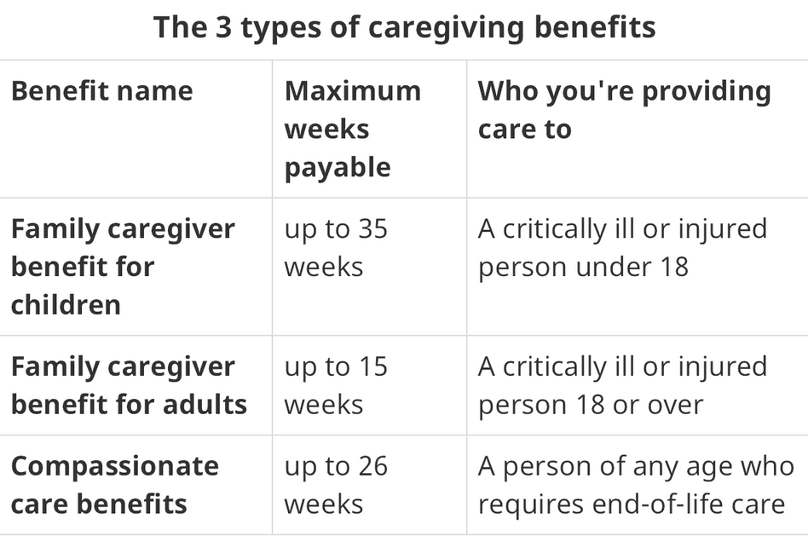
Employment Insurance Caregiving Beneftis and Leave
Descriptions
Provides Financial assitance
Earn 55% of your earning, upto $650 per week
You don’t have a related, but must be consider as a family member
Max 52 weeks of benefits following the date person is certified
Person has to be certified by MRP or NP
https://www.canada.ca/en/services/benefits/ei/caregiving.html
(Service Canada, 2023)

Slide 10
Employment Insurance Caregiving Beneftis and Leave
Rationale
Informal Caregivers:
Contributes to sustainability of formal care system
$25 billion
Canada
Provide 70-90% of care for elderly in Canada
£119 billion UK
Participate in economy and contribute in society
(Khayatzdeh-Mahani & Leslie, 2018)
Informal Caregivers Burnout:
Spend approximately 20 hours/week
limited social engagement
limited participation in paid labour
Increase physical and mental health problems
(Statistics Canada, 2022)

Slide 11
Employment Insurance Caregiving Beneftis and Leave
Successes:
Financial Assistance to almost 2 million Canadian every year
Consider various family dynamics
Provide benefits for approximately 9 months to 1 year
(Service Canada, 2023)
Easier to find and understand
Findability rates are 84%
Overall EI success is 79%
https://www.canada.ca/en/services/benefits/ei/caregiving.html
(Service Canada, 2018)

Slide 12
Employment Insurance Caregiving Beneftis and Leave
Challenges:
Specific criteria to be eligible
Require MRP or NP notice
1 Week of waiting period
28 days to process the application
Does not resonate with the cost of living
Earning has decreased by >40% for at least 1 week
accumulated 600 insured hours in the last 52 weeks
(Service Canada, 2023)

Slide 13
Employment Insurance Caregiving Beneftis and Leave
Deconstruction of Solution
1 week of waiting period should be elminated
Quicker processing time (e.g. 3-5 business days)
Resonate with the cost of living and increase benefits accordingly
Reduce the insured hours to facilitate and support the informal caregivers
More research and surveys to tailor the benefits based on public feedback (work with people rather than for people analogy)
(Service Canada, 2023; Statistics Canada, 2022)

Slide 14
Is this the priority solution?
NO!
Financial Constraints or limited budget
Policy Level
Time commitments
Very Limited research

Slide 15
Counselling via phone
Over The Phone Counselling

Slide 16
Introduction
Informal Caregivers Experience
social isolation,
a disruption to their own life, and
extreme emotional strain.
(Karimirad et al., 2021)
24/7 Hotline Initiatives results in:
ease of availability
flexible timelines to meet individual needs
(BC Mental Health & Substance Use Services, 2023)

Slide 17
Why Its Important
In BC
26% of the population provides homecare are caregivers
Accounting for 14.7 billion in economic growth
Informal caregivers provide 80% of at-home care
Barriers: Stress, fatigue, frustration --> Burnouts
Informal caregivers of chronically ill individuals provide the majority of long-term care leading to:
Emotional and financial strain
Social isolation
Disruption to work and family life
Decrease in self-care
Economic complications
Family turbulence
(Interior Health, 2023)
(Karimirad et al., 2021)

Slide 18
Novel Solution
NO!
Similar ideas and strategies have been previously implemented, and are currently active.
Unfortunately, many of these resources provided by other programs and initiatives have been lacking in resources, counselling, or funding, reducing the availability of the resource and in turn reducing its effectiveness.

Slide 19
Caregivers of B.C
The Gold Standard
Goal
Through the Caregivers of BC hotline an individual would find:
Provide over the phone counselling
Information and referral to resources
Healthcare navigation
Emotional support
Access to support groups
Access to webinars, articles, and resources specific to your needs
Listen with compassion
Provide unique individual care to each person who calls
Restraints
Caregiver support line is only available 8:30 am – 4:00 pm PT Monday to Friday
This support line is not B.C. provincially or government-run, or available 24 hours 7 days-a-week.
(Family Caregivers of B.C., 2023).

Slide 20
Rationale
We believe and through the supporting information of Caregivers of B.C the and their limited results as well as similar initiatives such as the B.C mental health hotline - that this solution if provided in a 24 hour 7 day a week option would provide a much needed support and fill a gap for those acting as informal caregivers.

Slide 21
Supporting Studies
Internet-Based Cognitive Behavioral Therapy for Informal Caregivers
Provincial crisis lines
These hotlines have been very effective in providing over-the-phone counselling and a reduction in their targeted areas (BC Mental Health & Substance Use Services, 2023).
Through the study it was concluded that internet delivered cognitive behavioral therapy (ICBT), through a therapist guided format, can decrease stress, anxiety, and depression, while increasing quality of life (Biliunaite et al., 2021).
Brief telephone counselling
Three short counseling phone consultations. They were focused on stress reduction, development of self-management skills, and how to deal with challenging behaviors (Berndt et al., 2019).

Slide 22
Not the Priority
Successes
Challenges
Reduced caregiver anxiety
Reduced sense of isolation
Reduced stress
Comformative to a busy schedule
Reduced sense of burden
Increased emotional/mental health
Increased access to resources
Increased access to professionals who can counsel
Increased Quality of Life
Restraints:
Funding
Personnel
Management
Advertisement
Lack of resources
Lack of literature/research to support it
Accessible to only those with the ability to look up the number and call
Sustainability concerns.
Government, municipal, private and/or non profit supports required.
(Biliunaite et al., 2021; Family Caregivers of B.C., 2023)

Slide 23
Home Support
An Extra Person
for Extra Help

Slide 24
What is it
Within the community:
We see an aging population.
We see an increase in chronic illnesses.
BC support services have begun directing its care towards community-based care of Community Living British Columbia.
40,000 clients are served each year (Office of the Seniors Advocate, 2019).
Different needs of the given client may require different levels of care available with home support, community nursing, and physical or occupational therapy (Office of the Seniors Advocate, 2019).

Slide 25
Restrictions
Scope of practice
changing client needs
Inconsistent information
Employee turnover
(Office of the Seniors Advocate, 2019)

Slide 26
Art gallery
Changing Tasks
Staff Retention
Standard
Information
Changing the autonomy of the employee so that they can modify their own schedule to fit both their own time and the client (Office of the Seniors Advocate, 2019).
Incentives could include paid training, increased compensation, and stable part-time as well as full-time positions (Office of the Seniors Advocate, 2019).
A universal set of policies and procedures can be presented that all employees follow (Office of the Seniors Advocate, 2019).

Slide 27
SUMMARY
Solution 1: Employment Insurance Caregiving Benefits and Leave
Solution 2: Counselling via Phone
Solution 3: Respite Care/ Home Support

Slide 28
SLIDO
Out of the three solutions we discussed, which one would you have picked as the priority solution?

Slide 29
THE END

